Slide 1

Prediction of Breast Cancer using Machine Learning Algorithms
Prepared by:
Varshitha A

Slide 2
Summary
Abstract
Problem statement
Proposed solution & result analysis
Dataset
Prediction of Model
Conclusion & future scope
References

Slide 3
Abstract
Breast cancer is considered one of the most common cancers in women caused by various clinical, lifestyle, social, and economic factors. Machine learning has the potential to predict breast cancer based on features hidden in data.
There are two early detection strategies for breast cancer: early diagnosis and screening.
The goal is to increase the proportion of breast cancers identified at an early stage, allowing for more effective treatment to be used and reducing the risks of death from breast cancer. Since early detection of cancer is key to effective treatment of breast cancer, we use various machine learning algorithms for prediction.

Slide 4
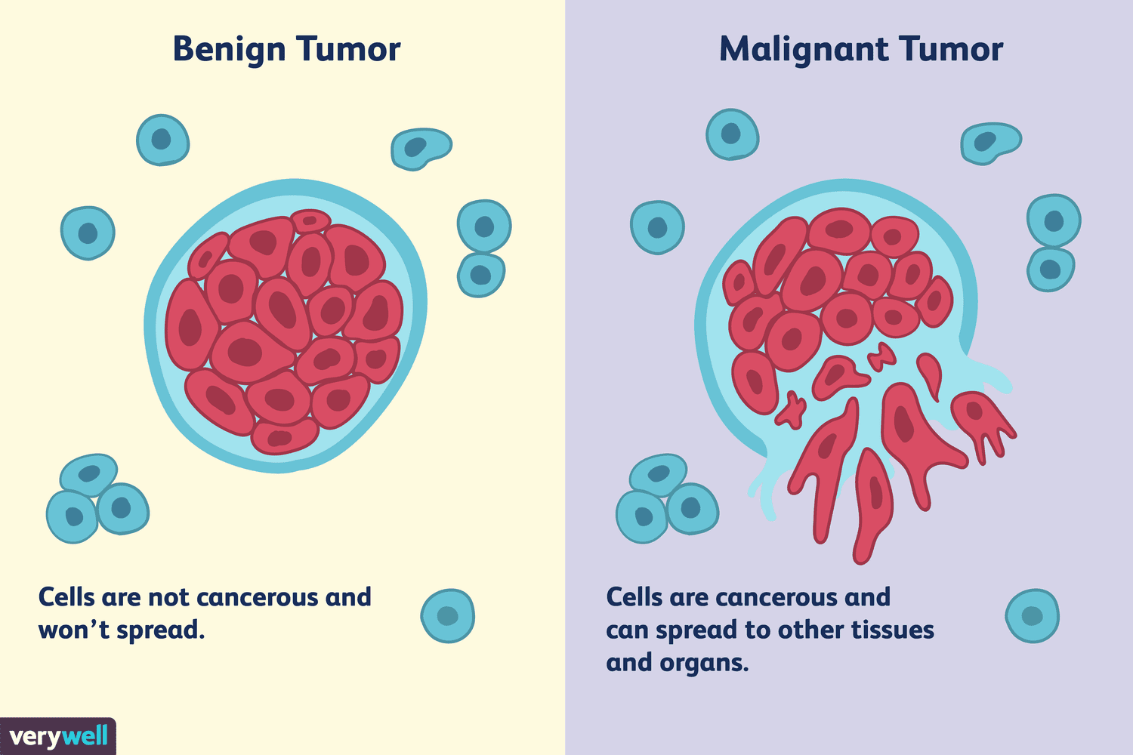
PROBLEM STATEMENT
Predicting person tumour (Malignant or Benign) based upon his/her tumour features i.e. its radius, area, smoothness, texture, perimeter.
Machine learning classification techniques can be used on these type of problem statement.

Slide 5
PROPOSED SOLUTION
The dataset used here was created by Dr. William H. Walberg, physician at the University Of Wisconsin Hospital.
To create the dataset fluid samples, taken from patients with solid breast masses and an easy-to-use graphical computer program called Xcyt(Cytological Diagnosis), which is capable of perform the analysis of cytological features based on a digital scan.
The dataset uses a curve-fitting algorithm, to compute ten features from each one of the cells in the sample, then it calculates the mean value, extreme value and standard error.

Slide 6
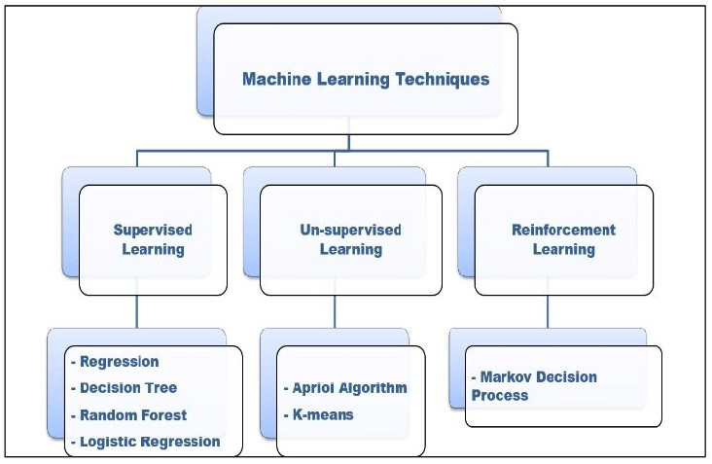
RESULT ANALYSIS
MACHINE LEARNING WITH PYTHON
Python libraries such as pandas, NumPy.
Sklearn library used with many subordinate models such as model_selection, classifiers and metrics etc.
JUPITOR Notebook for implementation purpose.

Slide 7
DATASET
ATTRIBUTIES:
diagnosis : The diagnosis of the breast tissues(1=malignant,0=benign)
mean radius : (mean of distances from center to points on the perimeter)
mean texture : (standard deviation of gray-scale values)
mean perimeter : (mean size of the core tumour)
mean area
mean smoothness : (mean of local variation in radius lengths)

Slide 8
Prediction of Model
The accuracy of the model is 77% so we can see a few wrong predictions but mostly this model is successful in predicting a tumor Malignant (M) (harmful) or Benign (B) (not harmful) based upon the features provided in the data .

Slide 9
CONCLUSION & FUTURE SCOPE
In this project in python, I learned to build a breast cancer tumour predictor on the wisconsin dataset and created graphs and results for the same. It has been observed that a good dataset provides better accuracy. Selection of appropriate algorithms with good home dataset will lead to the development of prediction systems. These systems can assist in proper treatment methods for a patient diagnosed with breast cancer. There are many treatments for a patient based on breast cancer stage; data mining and machine learning can be a very good help in deciding the line of treatment to be followed by extracting knowledge from such suitable databases.

Slide 10
REFERENCES
https://www.who.int/cancer/prevention/dia gnosis-screening/breast-cancer/en/
https://towardsdatascience.com/
https://seaborn.pydata.org/tutorial/axis_gri ds.html
https://seaborn.pydata.org/generated/seabo rn.pairplot.html
https://seaborn.pydata.org/generated/seabo rn.heatmap.html

Slide 11
THANK YOU

